Slide 1

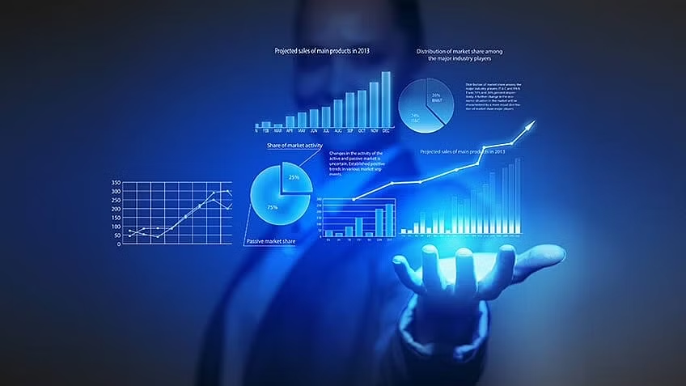
Data Analytics Industry
Notes:
https://www.ibm.com/topics/business-intelligence

Slide 2


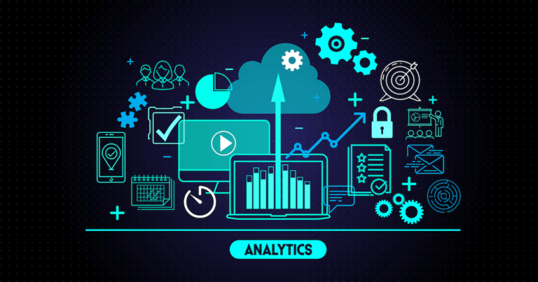
Introduction
Data analytics is the practice of analyzing, interpreting, and deriving insights from large volumes of data to drive informed decision making.
In today's digital age, where data is generated at an unprecedented pace, data analytics plays a crucial role in transforming raw data into valuable insights.

Slide 3
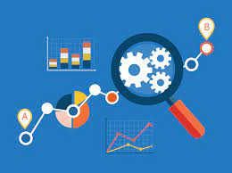
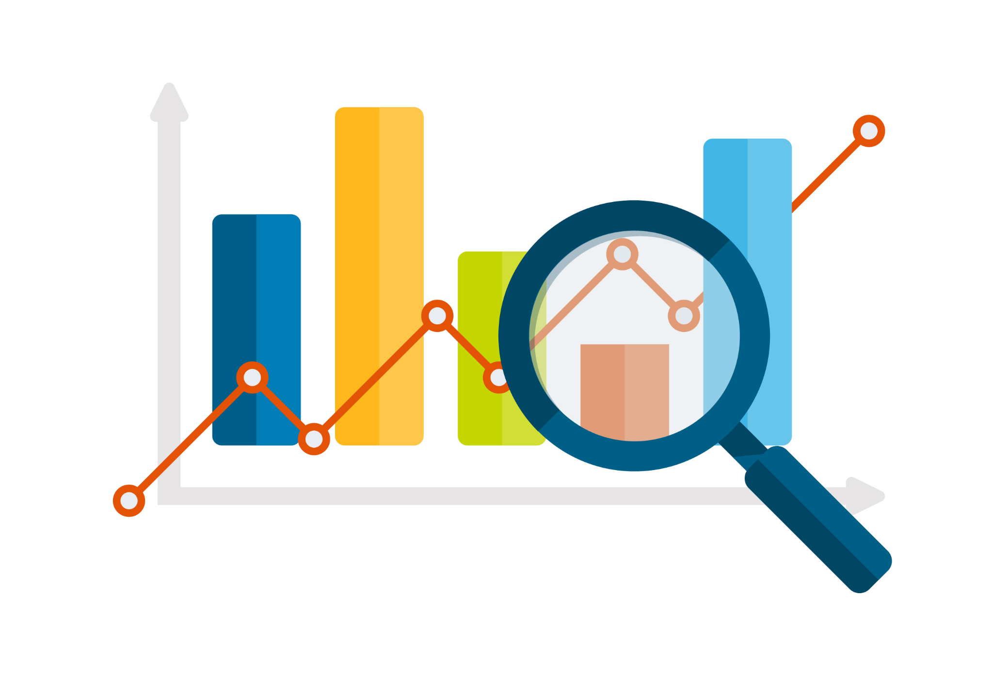
Significance of Data Analytics
Impact on Business Performance
Data-driven decision making has become essential for businesses to gain a competitive edge in the market.
By leveraging data analytics, organizations can uncover patterns, trends, and correlations within their data, enabling them to make informed and strategic decisions.
Data analytics helps businesses identify opportunities, optimize processes, mitigate risks, and enhance overall performance.
Companies that embrace data analytics gain a competitive advantage by making informed decisions that are backed by data and insights.
Data-driven organizations can better understand their customers' needs, preferences, and pain points, allowing them to deliver personalized experiences and targeted marketing campaigns.
Data analytics also helps businesses optimize their operations, reduce costs, and drive innovation.

Slide 4

Evolution of Data Analytics:
Data analytics has come a long way from traditional methods to advanced techniques, driven by technological advancements and increasing data availability.
Traditional Methods
In the past, data analysis was primarily performed manually, relying on spreadsheets and basic statistical methods.
Analysis was often limited to small datasets, making it challenging to extract meaningful insights.
Technological Advancements
The advent of advanced computing power and storage capabilities revolutionized the data analytics landscape.
Today, organizations have access to vast amounts of data from multiple sources, including social media, IoT devices, and online transactions.
Modern Techniques
With the emergence of big data, machine learning, and artificial intelligence, data analytics has reached new heights.
Advanced algorithms and models can now process and analyze large datasets quickly, uncovering complex patterns.

Slide 5
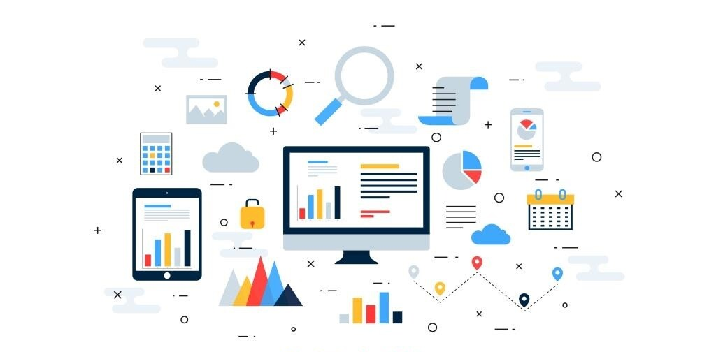
Key Components of Data Analytics
Data analytics is a multifaceted process that involves several key components to extract valuable insights from data. Understanding these components is crucial in harnessing the power of data to make informed decisions and gain a competitive advantage. Let's explore the three key components of data analytics
Data Collection
Data Cleaning and Preprocessing
Data Exploration and Visualization
Data Modeling and Analysis
Data Interpretation

Slide 6
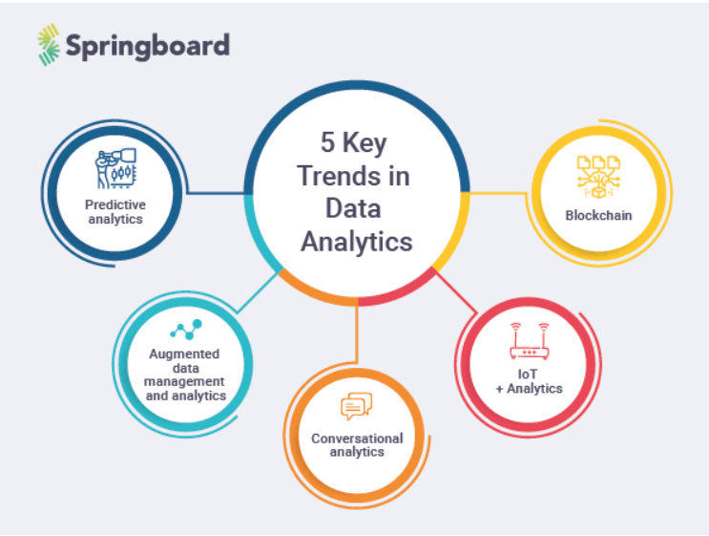
Key Trends in the Data Analytics Industry

Slide 7




Industry Applications
Finance Industry
Use of predictive analytics for fraud detection and risk assessment
Financial forecasting and portfolio optimization through data-driven insights
Customer segmentation and personalized financial recommendations
Healthcare Industry
Analysis of patient data to improve diagnosis and treatment outcomes
Predictive analytics for disease surveillance and early detection
Optimization of healthcare resource allocation and hospital operations
Retail Industry
Customer behavior analysis to enhance personalized marketing strategies
Demand forecasting and inventory management for improved supply chain efficiency
Sentiment analysis to understand customer feedback and enhance product offerings
Marketing Industry
Data-driven campaign management for targeted advertising and customer acquisition
Social media analytics to understand customer sentiment and influence marketing strategies
Customer segmentation and lifetime value analysis for effective marketing campaigns

Slide 8
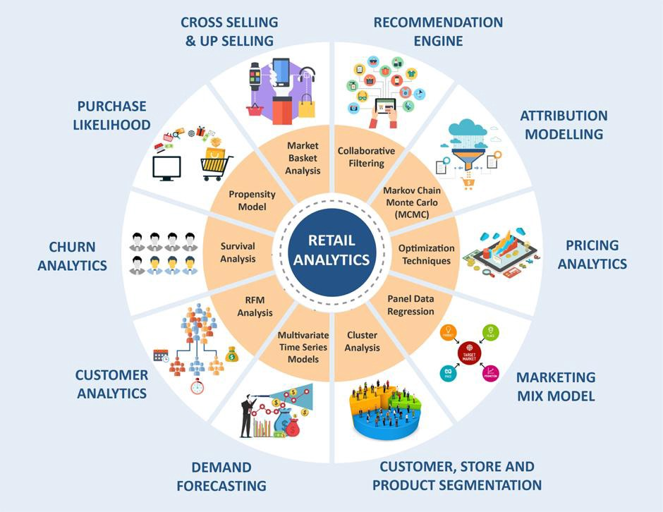
Example - Application in Retail Analytics

Slide 9

Career Opportunities
The data analytics industry is experiencing a significant demand for skilled professionals who can effectively analyze and interpret data.
The various career paths available in the field of data analytics-
Data Analyst
Business Analyst
Data Scientist
Business Intelligence Analyst
Data Engineer
Data Architect
Data Consultant

Slide 10

Skills Required
Technical Skills
Programming: Proficiency in programming languages such as Python, SQL ,Excel , machine learning for data manipulation and analysis.
Statistical Analysis: Strong understanding of statistical concepts and methods to analyze and interpret data effectively.Probabilty and statistics is must
Data Visualization: Ability to create visually appealing and informative data visualizations using tools like Tableau, Power BI, or Excel.
Soft Skills
Problem-Solving: Strong problem-solving abilities to identify business challenges, formulate analytical questions, and develop effective solutions.
Communication: Excellent verbal and written communication skills to present complex data insights
Collaboration: Ability to work effectively in cross-functional teams and collaborate with individuals from diverse backgrounds
Domain Knowledge
Understanding of the specific industry or domain in which data analytics will be applied (e.g., finance, healthcare, marketing).
Familiarity with industry-specific data sources, metrics, and challenges to derive meaningful insights

Slide 11

Industry Challenges
In the fast-paced world of data analytics, the industry faces several challenges that require careful consideration and proactive solutions. Let's explore some of the key challenges.
Data Privacy and Security Concerns
Data Quality Issues
Integration of Data Sources
Skills Gap and Talent Shortage
Keeping Pace with Technological Advancements

